Slide 1

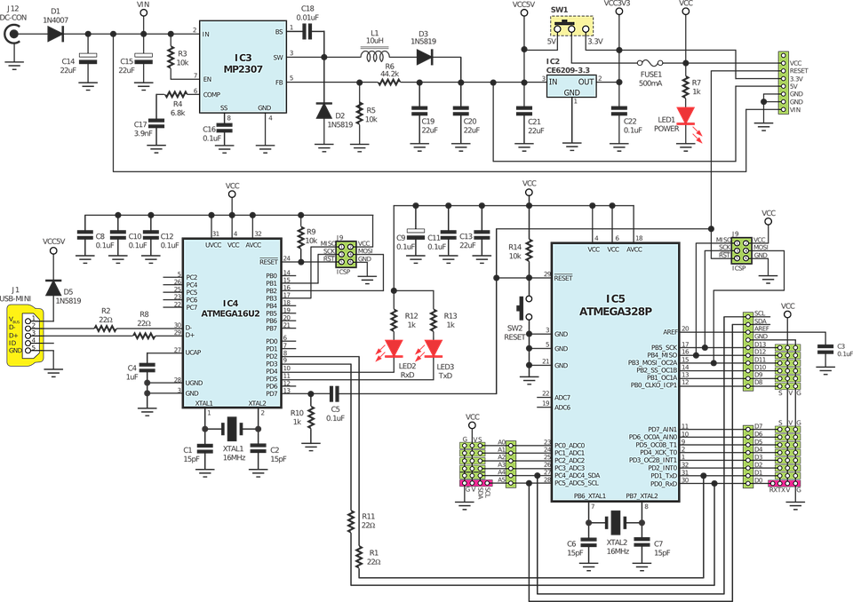
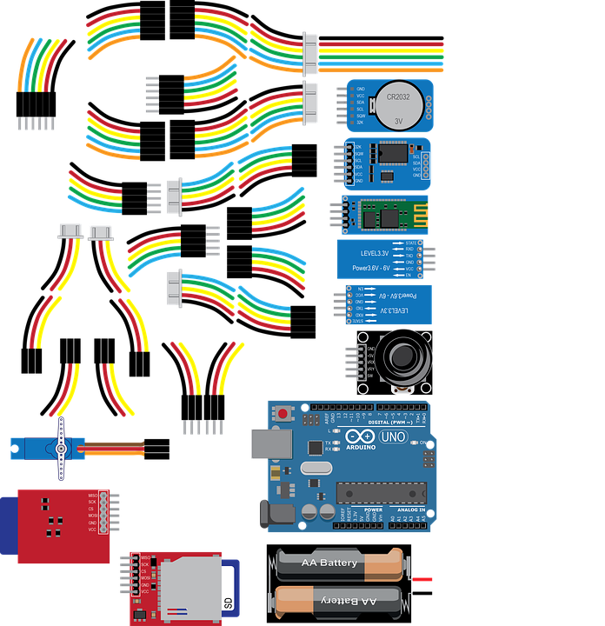
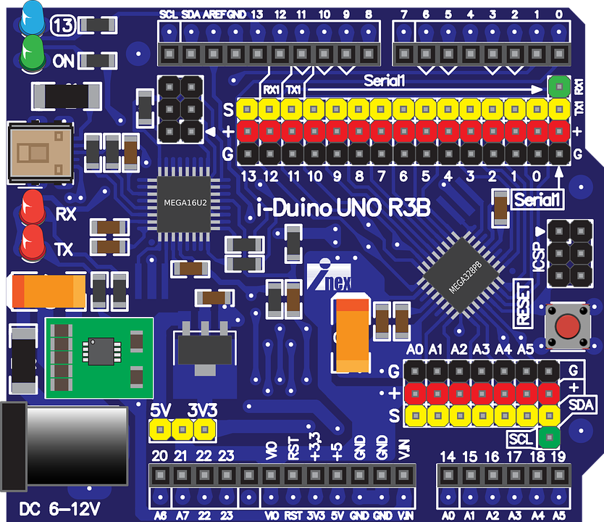
Arduino Structure and Design
Part 1

Slide 2
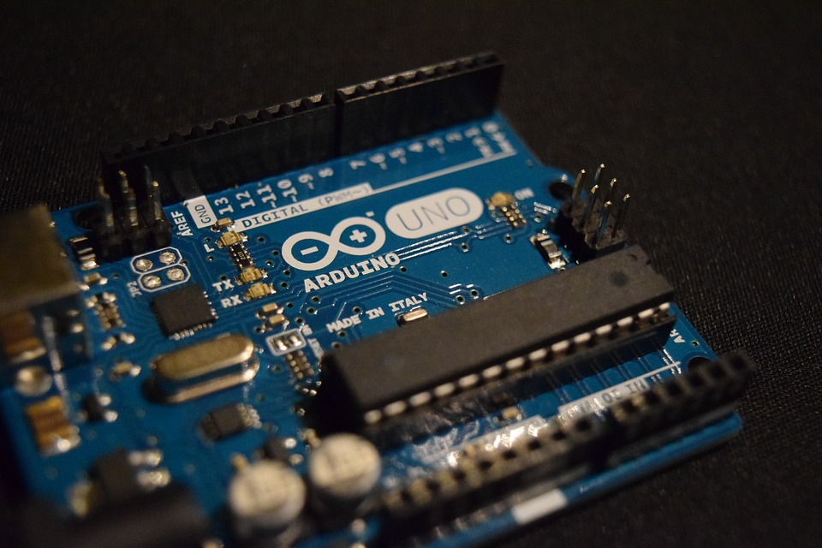

Slide 3
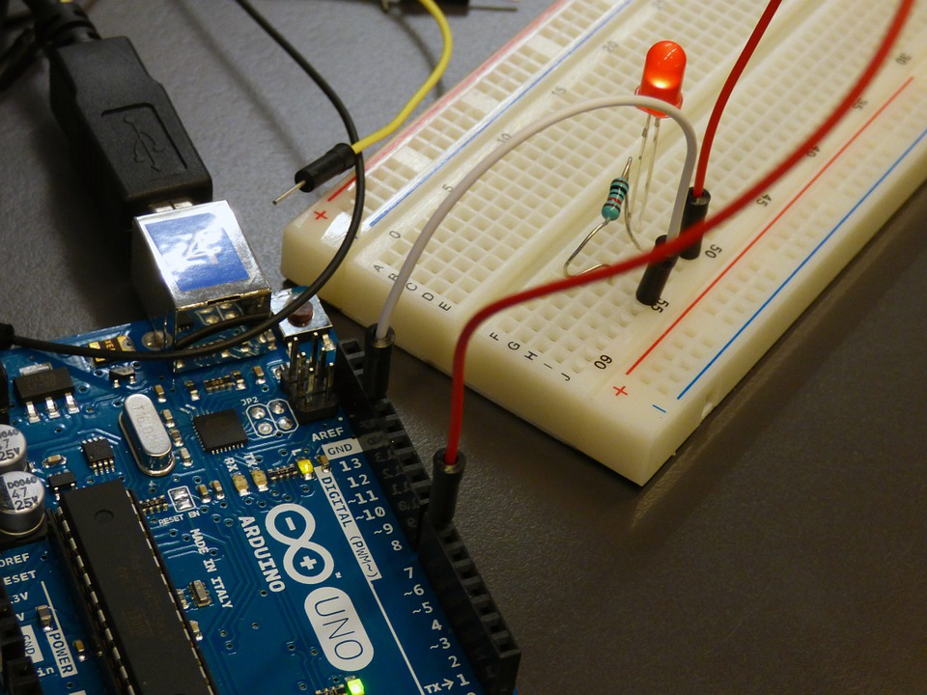

Slide 4
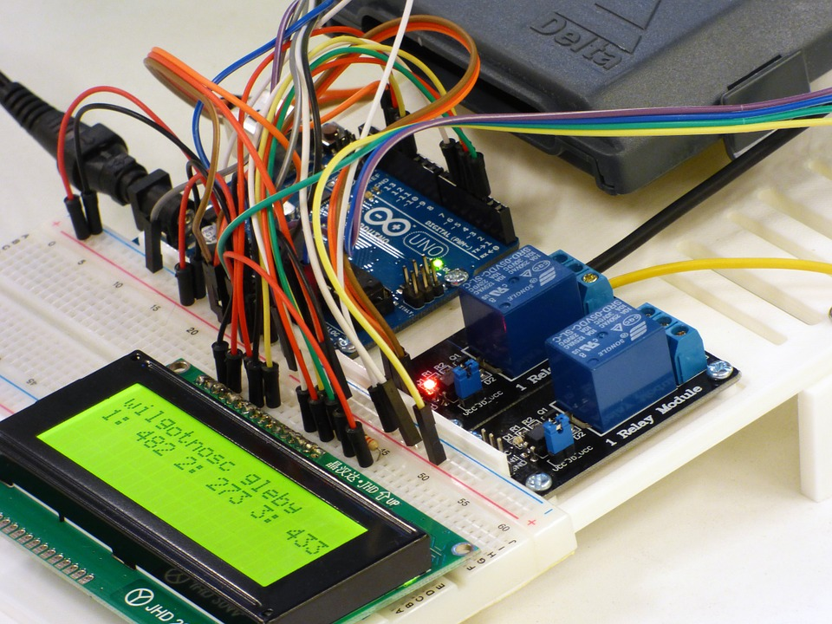

Slide 5
MCU
micro controller unit

Slide 6
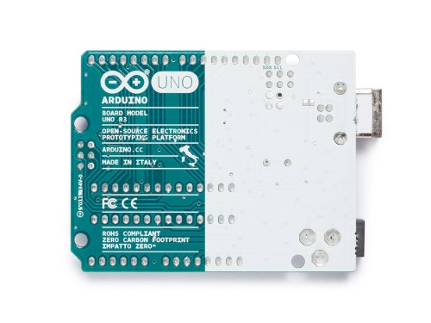
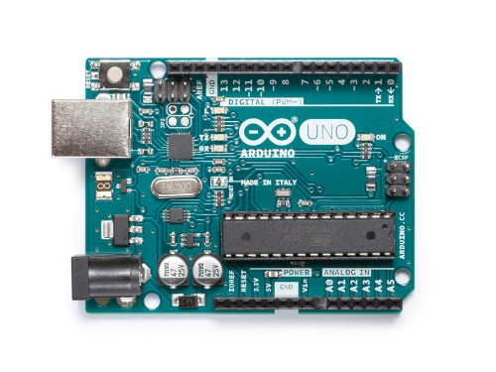
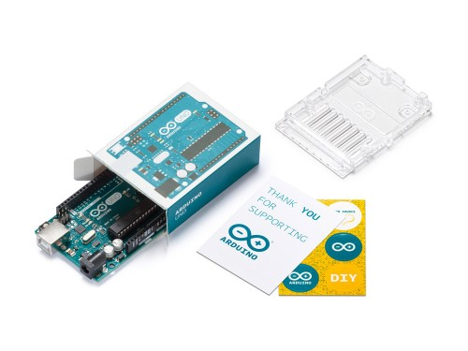
ARDUINO UNO REV3
Code: A000066

Slide 7
ARDUINO UNO REV3
Code: A000066
Microcontroller | ATmega328P
Operating Voltage | 5V
Input Voltage (recommended) | 7-12V
Input Voltage (limit) | 6-20V
Digital I/O Pins | 14 (of which 6 provide PWM output)
PWM Digital I/O Pins | 6
Analog Input Pins | 6
DC Current per I/O Pin | 20 mA
DC Current for 3.3V Pin | 50 mA
Flash Memory | 32 KB (ATmega328P) of which 0.5 KB used by bootloader
SRAM | 2 KB (ATmega328P)
EEPROM | 1 KB (ATmega328P)
Clock Speed | 16 MHz
LED_BUILTIN | 13
Length | 68.6 mm
Width | 53.4 mm
Weight | 25 g

Slide 8
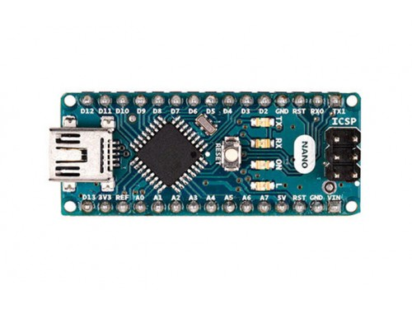
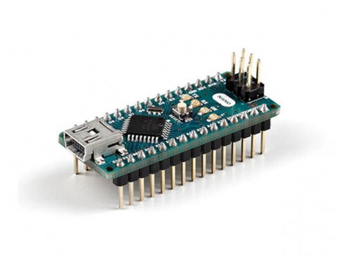
ARDUINO NANO
Code: A000005

Slide 9
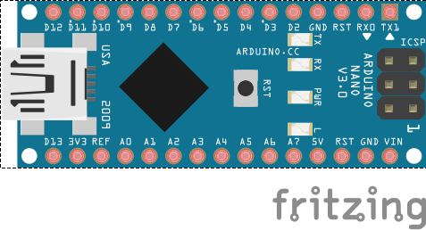
ARDUINO NANO
Code: A000005
Microcontroller | ATmega328
Architecture | AVR
Operating Voltage | 5 V
Flash Memory | 32 KB of which 2 KB used by bootloader
SRAM | 2 KB
Clock Speed | 16 MHz
Analog IN Pins | 8
EEPROM | 1 KB
DC Current per I/O Pins | 40 mA (I/O Pins)
Input Voltage | 7-12 V
Digital I/O Pins | 22 (6 of which are PWM)
PWM Output | 6
Power Consumption | 19 mA
PCB Size | 18 x 45 mm
Weight | 7 g
Product Code | A000005

Slide 10
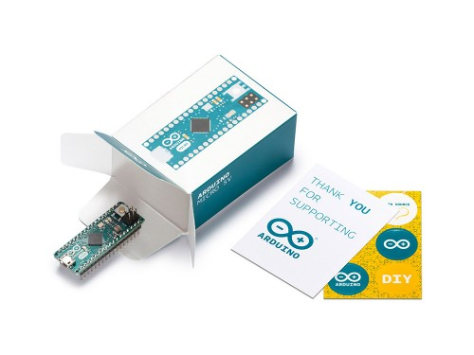
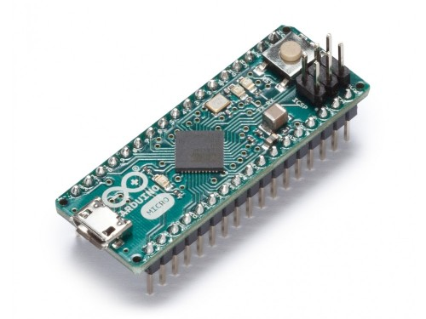
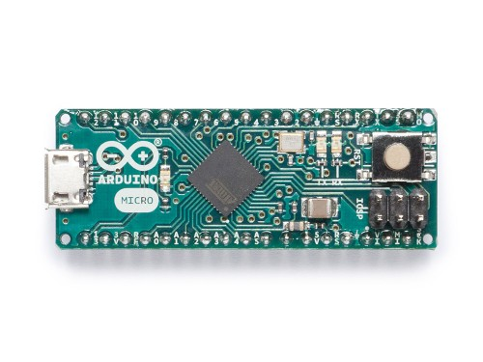
ARDUINO MICRO
Code: A000053

Slide 11
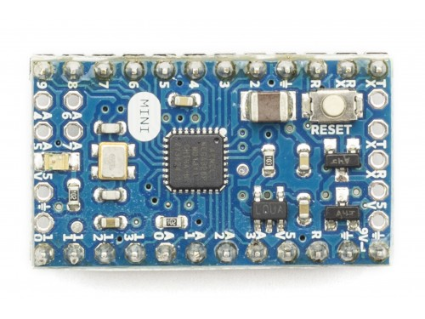
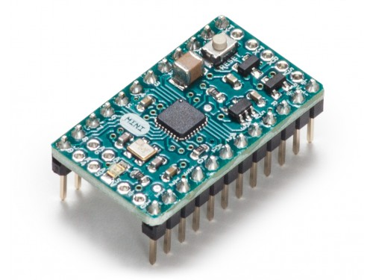
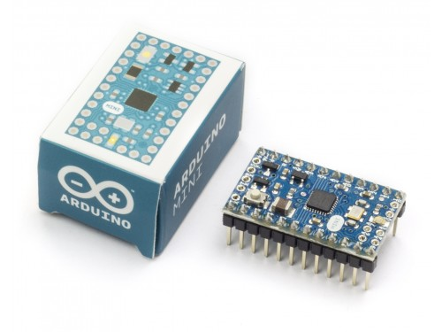
ARDUINO MINI 05
Code: A000087

Slide 12
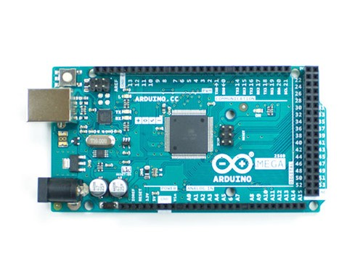
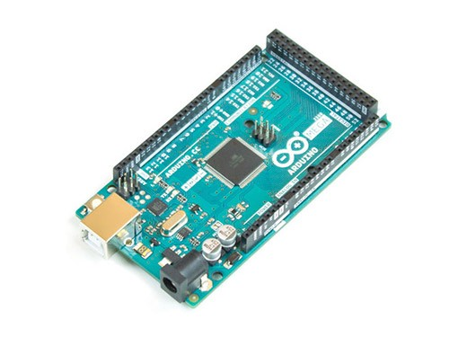
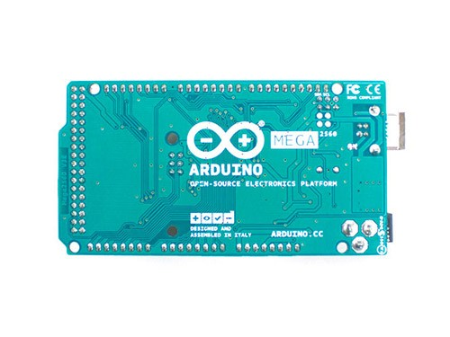
ARDUINO MEGA 2560 REV3
Code: A000067

Slide 13
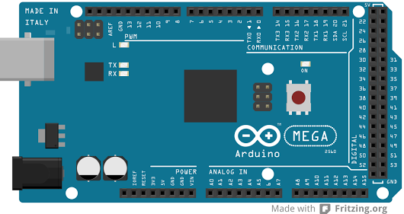
ARDUINO MEGA 2560 REV3
Code: A000067
Microcontroller | ATmega2560
Operating Voltage | 5V
Input Voltage (recommended) | 7-12V
Input Voltage (limit) | 6-20V
Digital I/O Pins | 54 (of which 15 provide PWM output)
Analog Input Pins | 16
DC Current per I/O Pin | 20 mA
DC Current for 3.3V Pin | 50 mA
Flash Memory | 256 KB of which 8 KB used by bootloader
SRAM | 8 KB
EEPROM | 4 KB
Clock Speed | 16 MHz
LED_BUILTIN | 13
Length | 101.52 mm
Width | 53.3 mm
Weight | 37 g

Slide 14
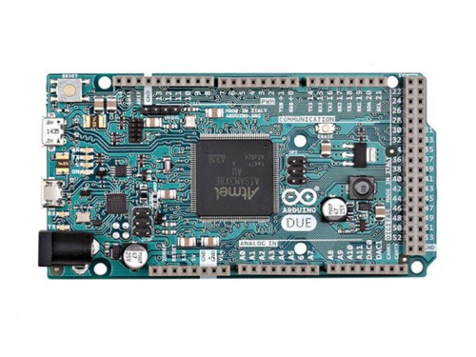
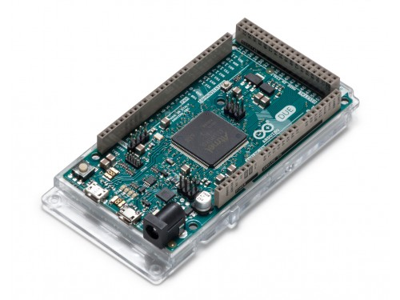
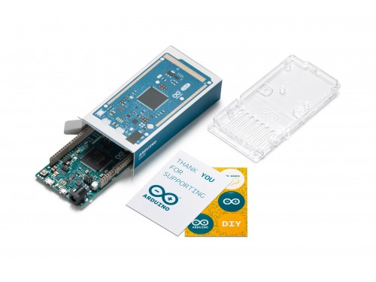
ARDUINO DUE
Code: A000062

Slide 15

www.Arduino.cc

Slide 16
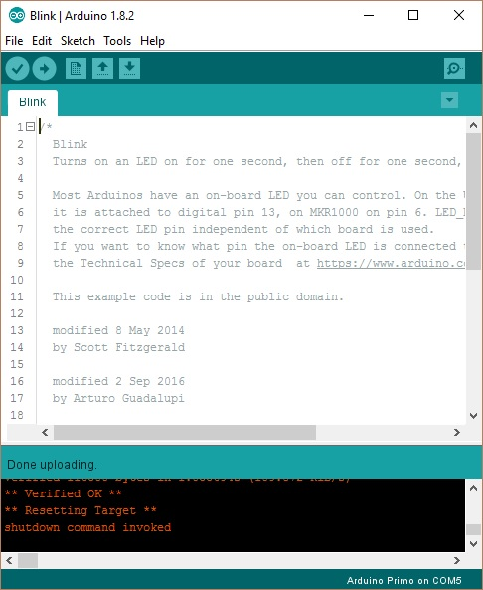
Arduino Sketch
Arduino IDE

Slide 17
CODE (.cpp)
Machine Language
C++ Compile
#include <iostream>
using namespace std;
int main() { … }
compiler
4d5a 9000 0300 0000 0400 0000 ffff 0000
b800 0000 0000 0000 4000 0000 0000 0000
0000 0000 0000 0000 0000 0000 0000 0000
0000 0000 0000 0000 0000 0000 d800 0000
0e1f ba0e 00b4 09cd 21b8 014c cd21 5468
6973 2070 726f 6772 616d 2063 616e 6e6f
7420 6265 2072 756e 2069 6e20 444f 5320
6d6f 6465 2e0d 0d0a 2400 0000 0000 0000
31b8 843a 75d9 ea69 75d9 ea69 75d9 ea69
b6d6 b569 77d9 ea69 75d9 eb69 eed9 ea69
b6d6 b769 64d9 ea69 21fa da69 7fd9 ea69
b2df ec69 74d9 ea69 5269 6368 75d9 ea69
0000 0000 0000 0000 0000 0000 0000 0000
0000 0000 0000 0000 5045 0000 4c01 0500
c1e3 1a4b 0000 0000 0000 0000 e000 0f01
0b01 0600 005a 0000 00d4 0100 0004 0000
cb30 0000 0010 0000 0070 0000 0000 4000
0010 0000 0002 0000 0400 0000 0600 0000
0400 0000 0000 0000 0000 0600 0004 0000
0000 0000 0200 0080 0000 1000 0010 0000
0000 1000 0010 0000 0000 0000 1000 0000
0000 0000 0000 0000 a473 0000 b400 0000
0020 0400 60d5 0100 0000 0000 0000 0000
0000 0000 0000 0000 0000 0000 0000 0000
0000 0000 0000 0000 0000 0000 0000 0000
0000 0000 0000 0000 0000 0000 0000 0000
0000 0000 0000 0000 0000 0000 0000 0000

Slide 18
Machine Language
4d5a 9000 0300 0000 0400 0000 ffff 0000
b800 0000 0000 0000 4000 0000 0000 0000
0000 0000 0000 0000 0000 0000 0000 0000
0000 0000 0000 0000 0000 0000 d800 0000
0e1f ba0e 00b4 09cd 21b8 014c cd21 5468
6973 2070 726f 6772 616d 2063 616e 6e6f
7420 6265 2072 756e 2069 6e20 444f 5320
6d6f 6465 2e0d 0d0a 2400 0000 0000 0000
31b8 843a 75d9 ea69 75d9 ea69 75d9 ea69
b6d6 b569 77d9 ea69 75d9 eb69 eed9 ea69
b6d6 b769 64d9 ea69 21fa da69 7fd9 ea69
b2df ec69 74d9 ea69 5269 6368 75d9 ea69
0000 0000 0000 0000 0000 0000 0000 0000
0000 0000 0000 0000 5045 0000 4c01 0500
c1e3 1a4b 0000 0000 0000 0000 e000 0f01
0b01 0600 005a 0000 00d4 0100 0004 0000
cb30 0000 0010 0000 0070 0000 0000 4000
0010 0000 0002 0000 0400 0000 0600 0000
0400 0000 0000 0000 0000 0600 0004 0000
0000 0000 0200 0080 0000 1000 0010 0000
0000 1000 0010 0000 0000 0000 1000 0000
0000 0000 0000 0000 a473 0000 b400 0000
0020 0400 60d5 0100 0000 0000 0000 0000
0000 0000 0000 0000 0000 0000 0000 0000
0000 0000 0000 0000 0000 0000 0000 0000
0000 0000 0000 0000 0000 0000 0000 0000
0000 0000 0000 0000 0000 0000 0000 0000

Slide 19
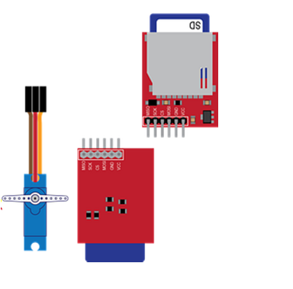
4d5a 9000 0300 0000 0400 0000 ffff 0000
b800 0000 0000 0000 4000 0000 0000 0000
0000 0000 0000 0000 0000 0000 0000 0000
0000 0000 0000 0000 0000 0000 d800 0000
0e1f ba0e 00b4 09cd 21b8 014c cd21 5468
6973 2070 726f 6772 616d 2063 616e 6e6f
7420 6265 2072 756e 2069 6e20 444f 5320
6d6f 6465 2e0d 0d0a 2400 0000 0000 0000
31b8 843a 75d9 ea69 75d9 ea69 75d9 ea69
b6d6 b569 77d9 ea69 75d9 eb69 eed9 ea69
b6d6 b769 64d9 ea69 21fa da69 7fd9 ea69
b2df ec69 74d9 ea69 5269 6368 75d9 ea69
0000 0000 0000 0000 0000 0000 0000 0000
0000 0000 0000 0000 5045 0000 4c01 0500
c1e3 1a4b 0000 0000 0000 0000 e000 0f01
0b01 0600 005a 0000 00d4 0100 0004 0000
cb30 0000 0010 0000 0070 0000 0000 4000
0010 0000 0002 0000 0400 0000 0600 0000
0400 0000 0000 0000 0000 0600 0004 0000
0000 0000 0200 0080 0000 1000 0010 0000
0000 1000 0010 0000 0000 0000 1000 0000
0000 0000 0000 0000 a473 0000 b400 0000
0020 0400 60d5 0100 0000 0000 0000 0000
0000 0000 0000 0000 0000 0000 0000 0000
0000 0000 0000 0000 0000 0000 0000 0000
0000 0000 0000 0000 0000 0000 0000 0000
0000 0000 0000 0000 0000 0000 0000 0000

Slide 20
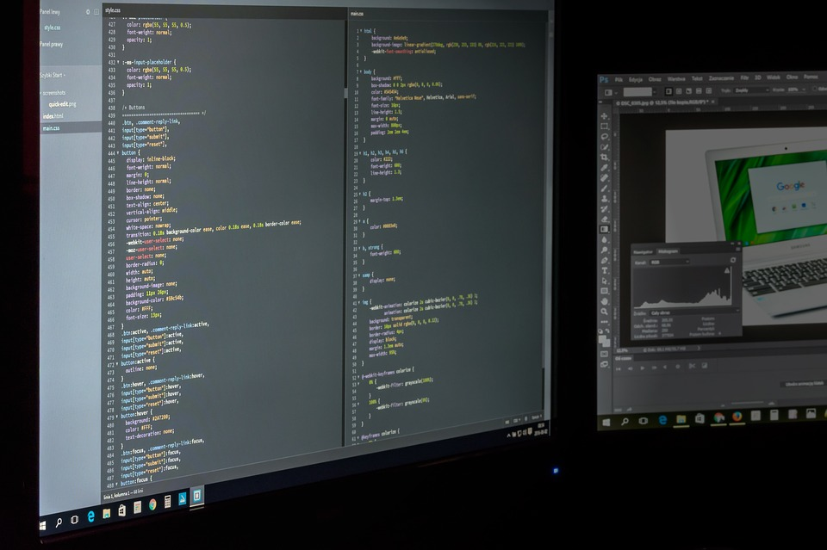

The C++ Programming Language

Slide 21
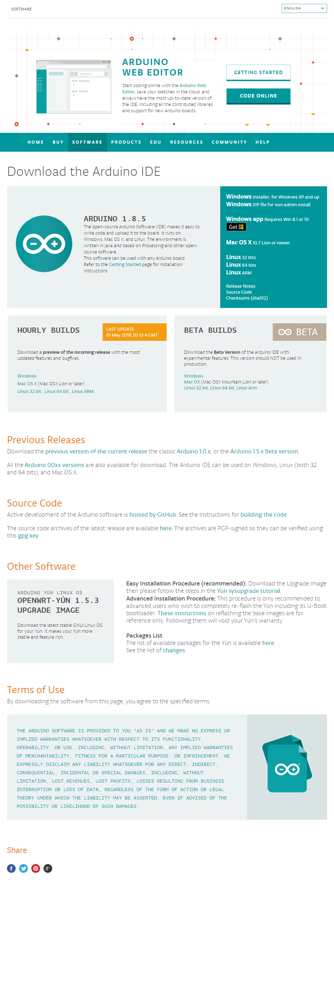

Slide 22
I/O Pin

Slide 23
Analog vs Digital

Slide 24
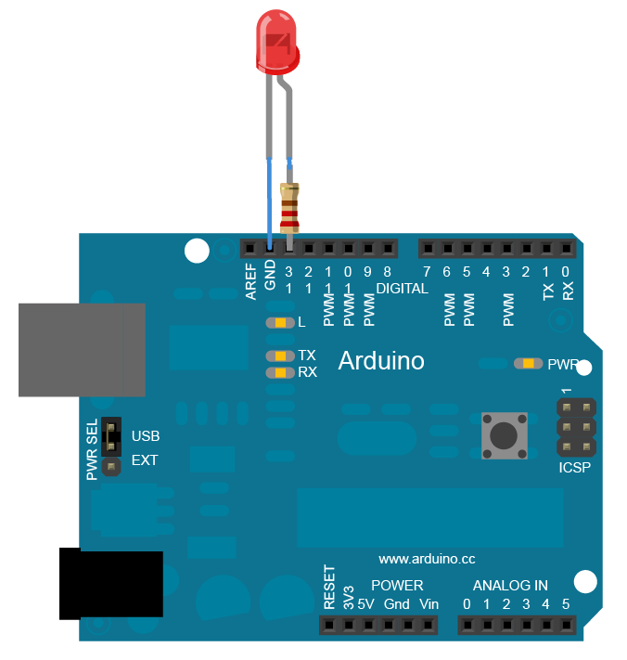
LED Control

Slide 25

.ino
// the setup function funs once when you press reset or power the board
void setup() {
// initialize digital pin 13 as on output
pinMode(13, OUTPUT);
}
// the loop function runs over and over again forever
void loop() {
digitalWrite(13, HIGH); // turns the LED on (HIGH is the voltage level)
delay(1000); // wait for a second
digitalWrite(13, LOW); // turn the LED off by making the voltage LOW
delay(1000); // wait for a second
}

Slide 26

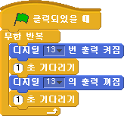

Slide 27
PWM
Pulse Width Modulation

Slide 28
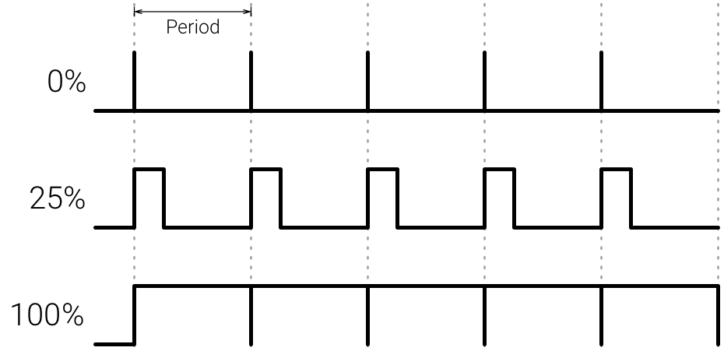

Slide 29


Slide 30
.ino
void setup() {
pinMode(3, OUTPUT);
}
void loop() {
for (int i=0; i<255; i++) {
analogWrite(3, i);
delay(100);
}
for (int i=255; i>0; i--) {
analogWrite(3, i);
delay(100);
}
}

Slide 31
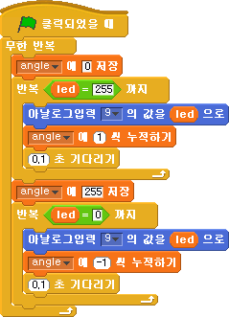

Slide 33
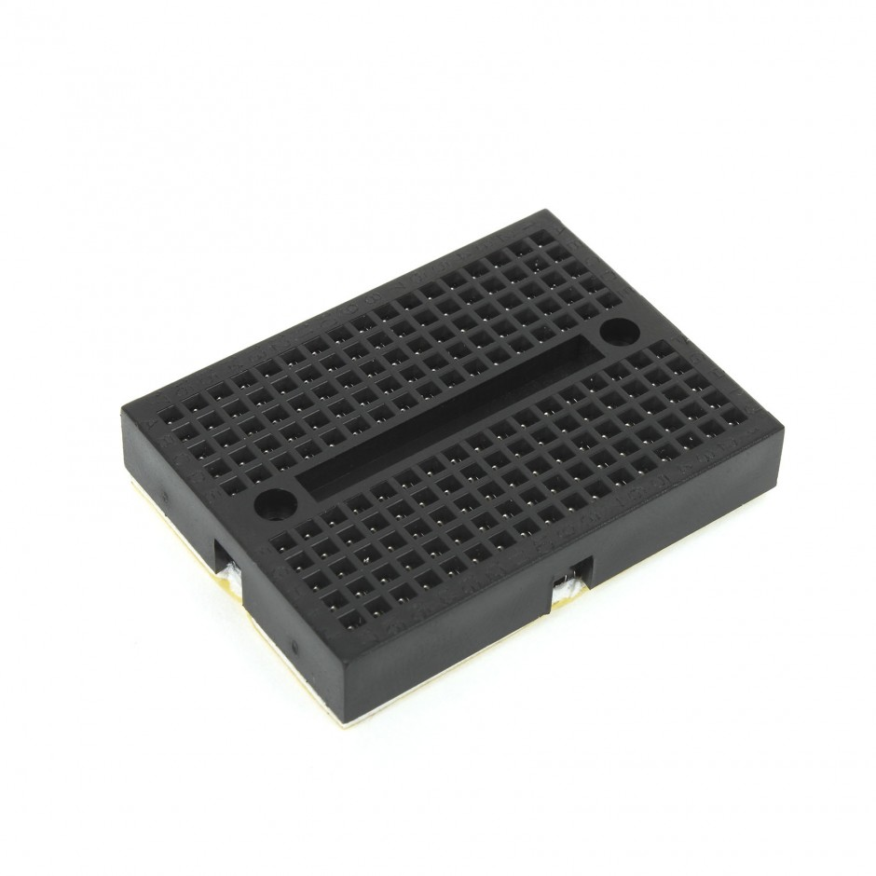
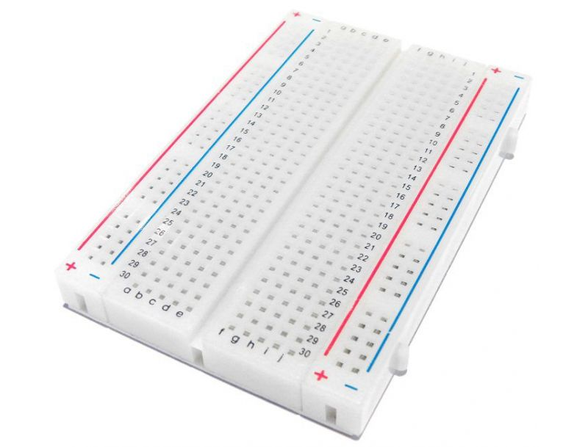
Breadboard

Slide 34
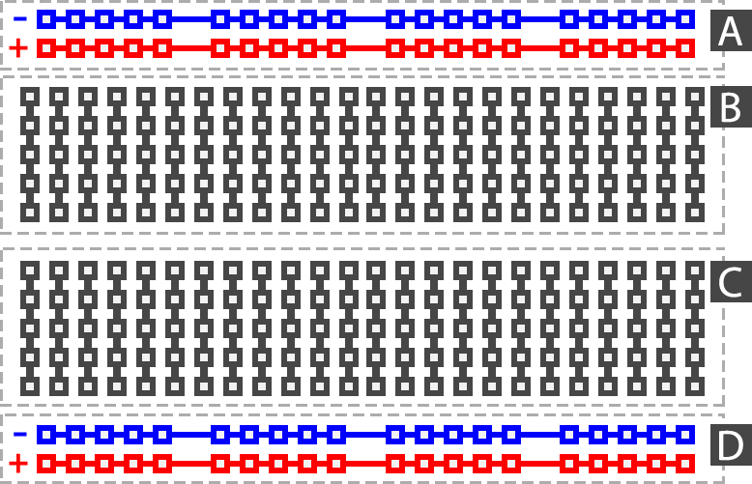

Slide 35
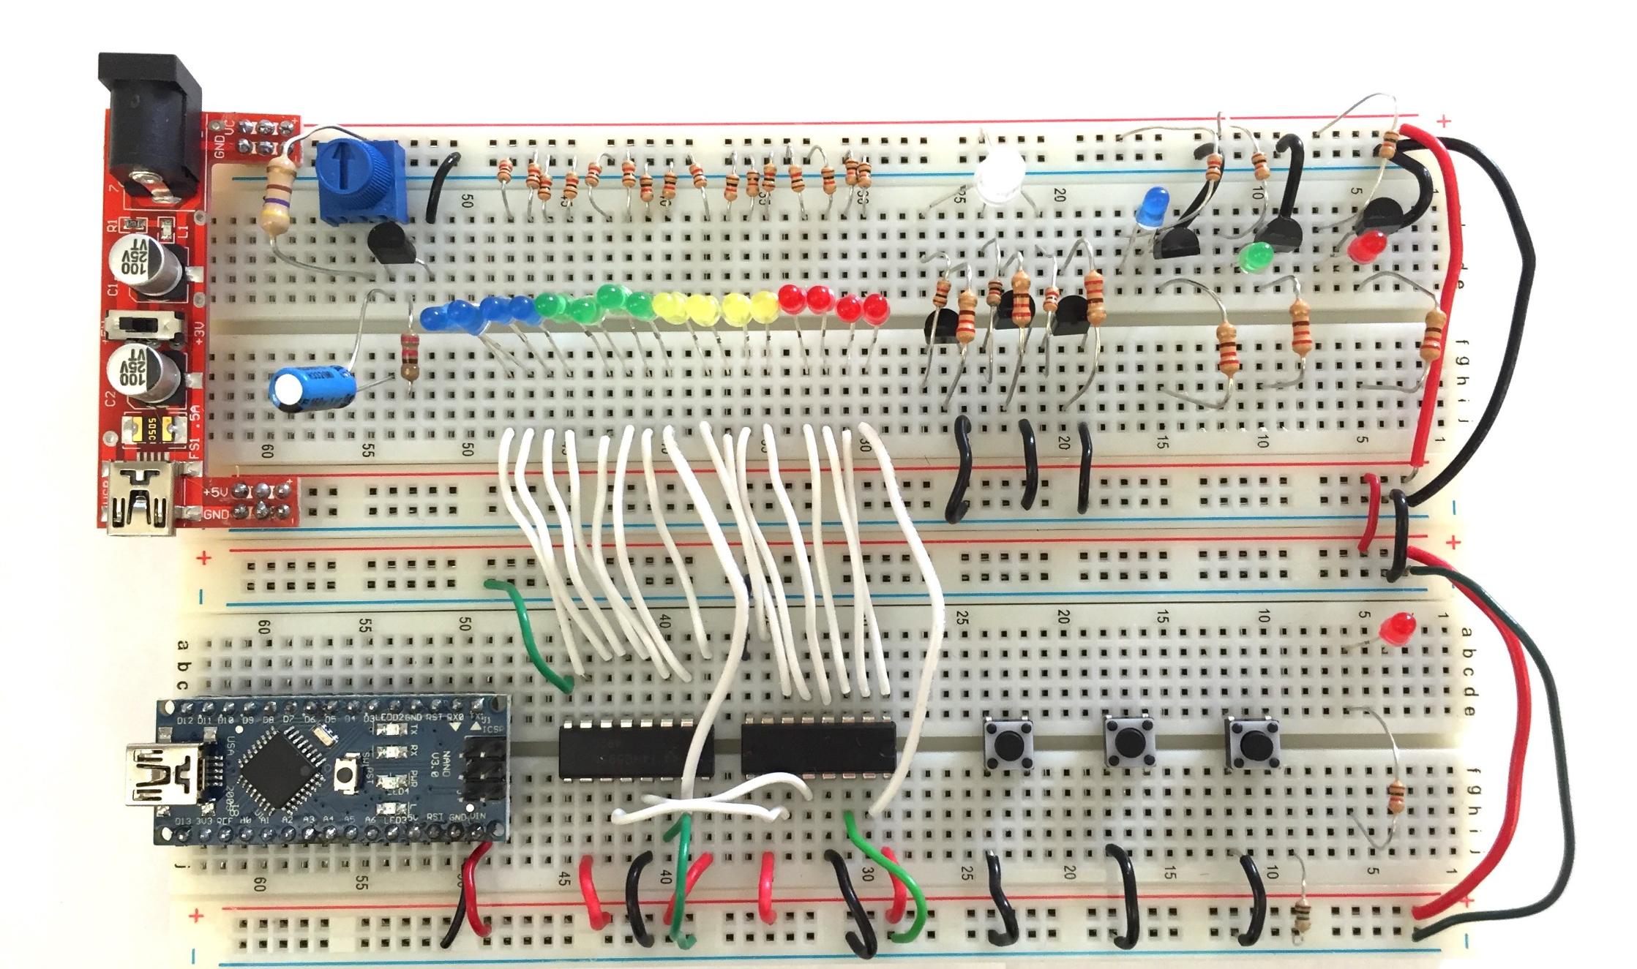

Slide 36
Vcc
GND

Slide 37
Sensor Connection

Slide 38
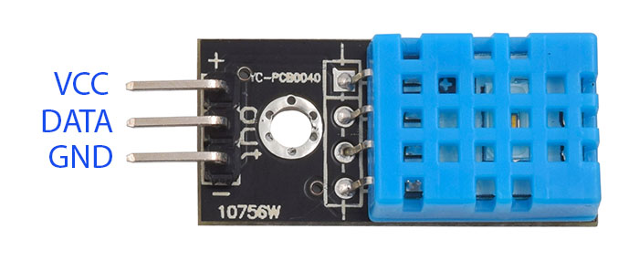

Slide 39
.ino
Digital Pin
Analog Pin
void setup() {
pinMode(3, INPUT_PULLUP);
Serial.begin(9600);
}
void loop() {
Serial.print(‘[DHT11 SENSOR] ’);
Serial.println(analogRead(3));
}
void setup() {
Serial.begin(9600);
}
void loop() {
Serial.print(‘[DHT11 SENSOR] ’);
Serial.println(analogRead(A1));
}

Slide 40


Slide 41
Motor Connection

Slide 42
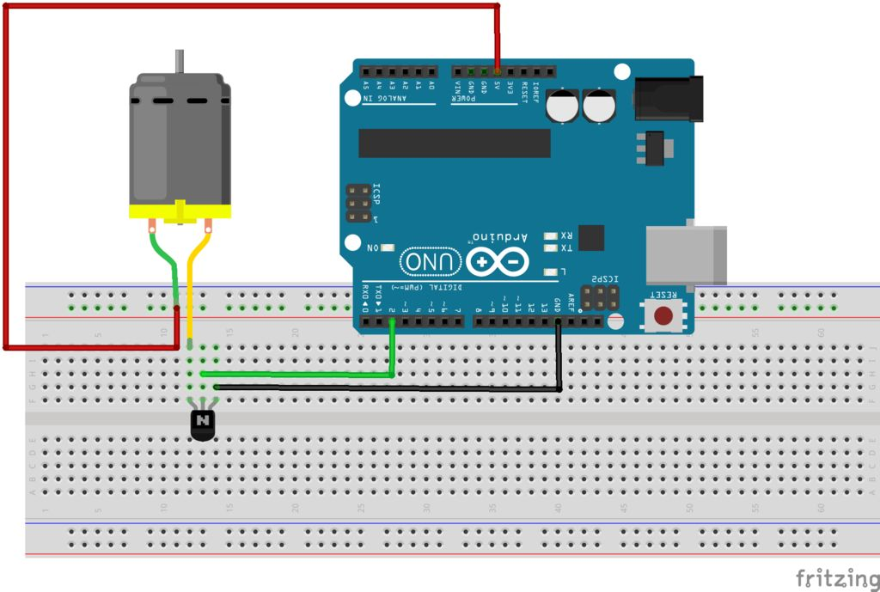
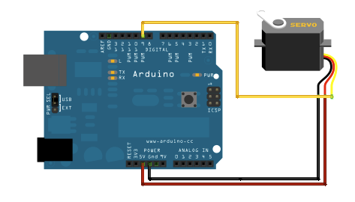
Servo Motor
DC Motor

Slide 43
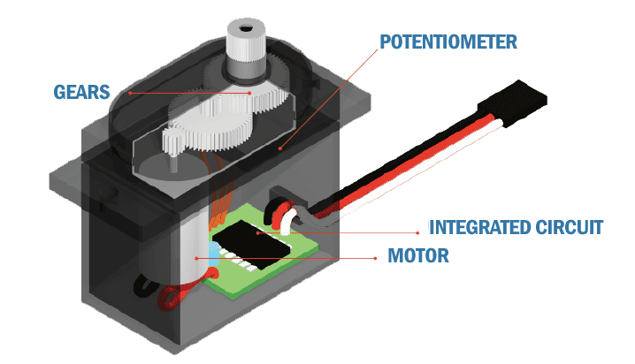

Slide 44
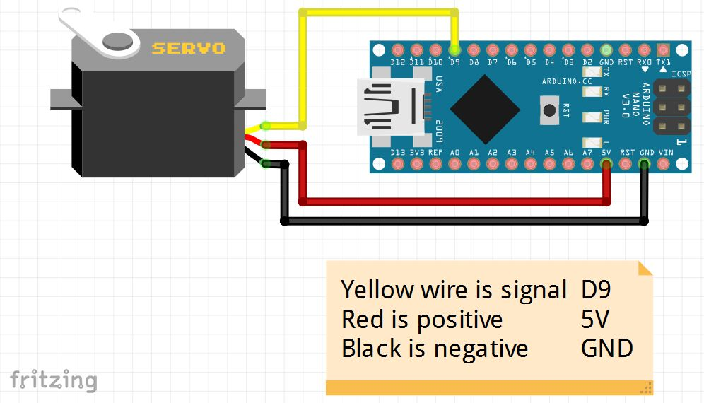

Slide 45
.ino
#include <Servo.h>
Servo motor;
void setup() {
motor.attach(3);
}
void loop() {
for (int i=0; i<180; i++) {
motor.write(i);
delay(100);
}
for (int i=180; i>0; i--) {
motor.write(i);
delay(100);
}
}

Slide 46
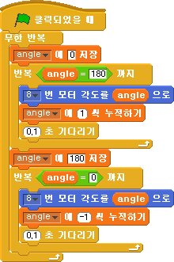

Slide 47
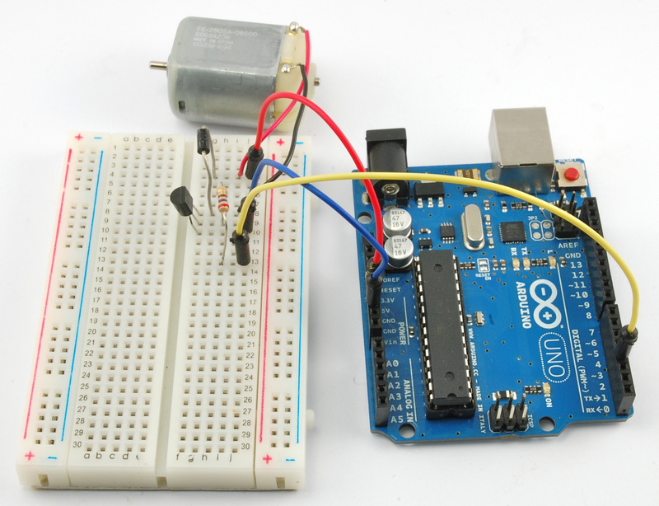

Slide 48
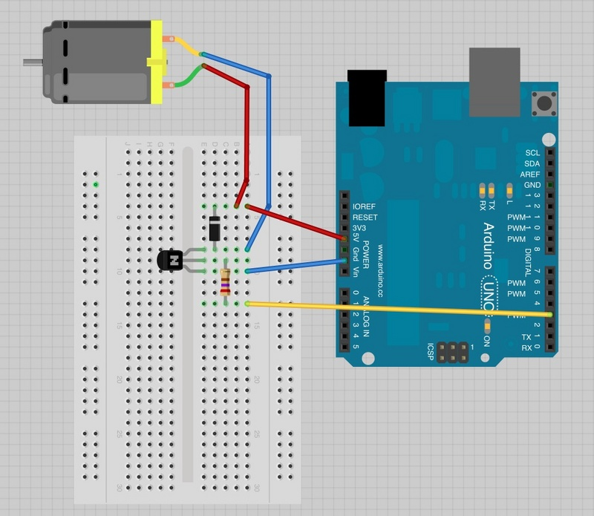

Slide 49
.ino
PWM - analogWrite
void setup() {
pinMode(3, OUTPUT);
}
void loop() {
for (int i=0; i<255; i++) {
analogWrite(3, i);
delay(100);
}
for (int i=255; i>0; i--) {
analogWrite(3, i);
delay(100);
}
}
digitalWrite
void setup() {
pinMode(3, OUTPUT);
}
void loop() {
digitalWrite(3, HIGH);
}

Slide 50
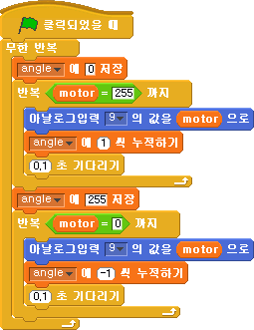


Slide 51
Push Button Connection

Slide 52
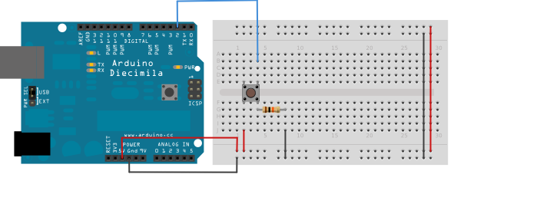

Slide 53
.ino
void setup() {
pinMode(2, INPUT_PULLUP);
pinMode(13, OUTPUT);
}
void loop() {
if (digitalRead(2) == HIGH) {
digitalWrite(13, HIGH);
} else {
digitalWrite(13, LOW);
}
}

Slide 54
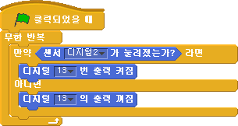

Slide 55

문제가 발생했을 때

Slide 56
“말은 쉽지, 코드를 보여줘.” ”Talk is cheap. Show me the code.”
- Linux Torvalds

Slide 57

Arduino Structure and Design
Part 2

Slide 58
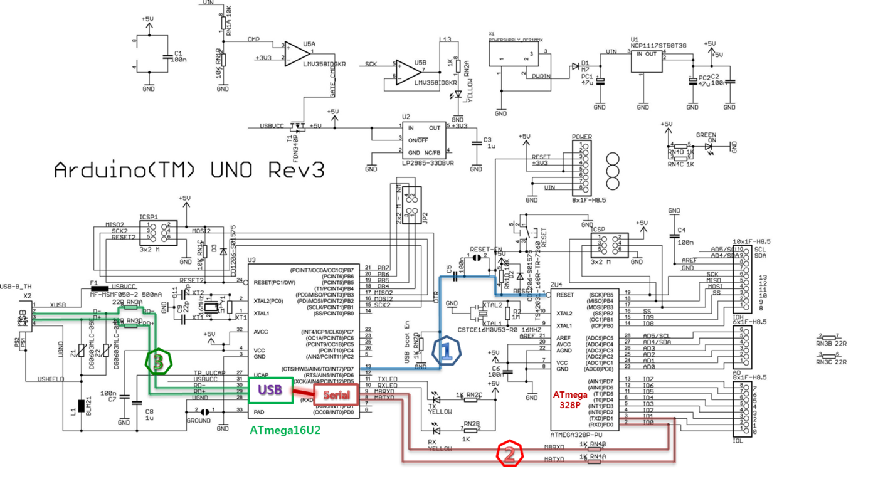
I/O Pins

Slide 62
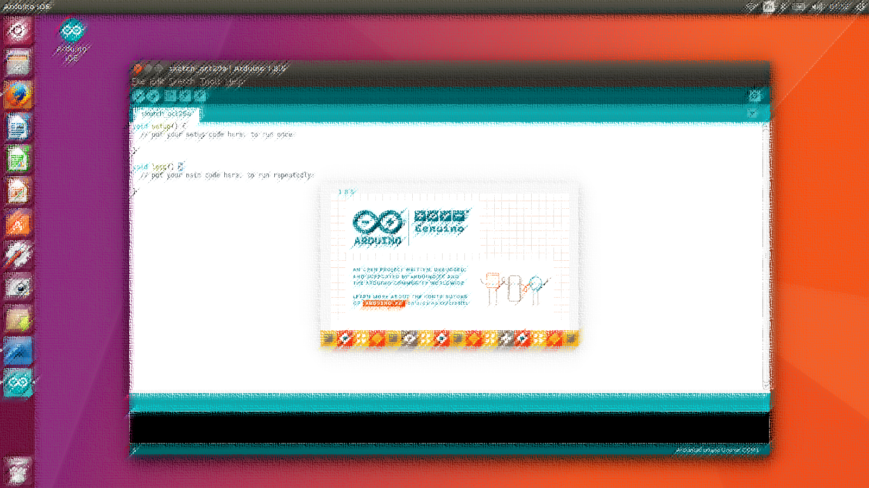


Slide 63
The C++ Programming Language

Slide 64
.ino
// the setup function funs once when you press reset or power the board
void setup() {
// initialize digital pin 13 as on output
pinMode(13, OUTPUT);
}
// the loop function runs over and over again forever
void loop() {
digitalWrite(13, HIGH); // turns the LED on (HIGH is the voltage level)
delay(1000); // wait for a second
digitalWrite(13, OUTPUT); // turn the LED off by making the voltage LOW
delay(1000); // wait for a second
}

Slide 65
function

Slide 66
PWM
Pulse Width Modulation

Slide 69


Slide 70

h bridge 회로

Slide 71
analogWrite();
int r = analogRead();

Slide 72
Serial communication

Slide 73


Slide 74

Arduino IDE Install
Coming soon …

Slide 75
S4A Install

Slide 76

http://s4a.cat/

Slide 77


Slide 78


Slide 79


